Slide 1
CST 205 OOP :Core Java Fundamentals

Slide 2
SYLLABUS
Primitive Data types - Integers, Floating Point Types, Characters, Boolean. Literals, Type Conversion and Casting, Variables, Arrays, Strings, Vector class.
Operators - Arithmetic Operators, Bitwise Operators, Relational Operators, Boolean Logical Operators, Assignment Operator, Conditional (Ternary) Operator, Operator Precedence.
Control Statements - Selection Statements, Iteration Statements and Jump Statements
Object Oriented Programming in Java - Class Fundamentals, Declaring Objects, Object Reference, Introduction to Methods, Constructors, this Keyword, Method Overloading, Using Objects as Parameters, Returning Objects, Recursion, Access Control, Static Members, Final Variables, Inner Classes, Command Line Arguments, Variable Length Arguments.
Inheritance - Super Class, Sub Class, The Keyword super, protected Members, Calling Order of Constructors, Method Overriding, the Object class, Abstract Classes and Methods, using final with Inheritance.

Slide 3
OBJECTIVES
To illustrate Control Statements –
Selection Statements,
Iteration Statements and
Jump Statements
CO2 Develop Java application programs using java constructs, operators, control statements, built in packages and libraries.

Slide 4
Control statements
A programming language uses control statements to cause the flow of execution to advance and branch based on changes to the state of a program.
Java’s program control statements can be put into the following categories: selection, iteration, and jump.
Selection statements allow your program to choose different paths of execution based upon the outcome of an expression or the state of a variable.
Iteration statements enable program execution to repeat one or more statements (that is, iteration statements form loops).
Jump statements allow your program to execute in a nonlinear fashion.

Slide 5
Java’s Selection Statements
Java supports two selection statements: if and switch.
These statements allow you to control the flow of your program’s execution based upon conditions known only during run time.
If
The if statement is Java’s conditional branch statement.
It can be used to route program execution through two different paths.
Here is the general form of the if statement:
if (condition) statement1;
else statement2;
Here, each statement may be a single statement or a compound statement enclosed in curly braces (that is, a block).
The condition is any expression that returns a boolean value. The else clause is optional.

Slide 6
Java’s Selection Statements
The if works like this: If the condition is true, then statement1 is executed. Otherwise, statement2 (if it exists) is executed. In no case will both statements be executed. For example,
Consider the following:
int a, b; // ... if(a < b) a = 0; else b = 0; | if (bytesAvailable > 0) { ProcessData(); bytesAvailable -= n; } else { waitForMoreData(); bytesAvailable = n; }

Slide 7
Java’s Selection Statements
Nested ifs
A nested if is an if statement that is the target of another if or else.
When you nest ifs, the main thing to remember is that an else statement always refers to the nearest if statement that is within the same block as the else and that is not already associated with an else.
if(i == 10)
{
if(j < 20) a = b;
if(k > 100) c = d; // this if is
else a = c; // associated with this else
}
else a = d; // this else refers to if(i == 10)

Slide 8
Java’s Selection Statements
Nested ifs
A nested if is an if statement that is the target of another if or else.
When you nest ifs, the main thing to remember is that an else statement always refers to the nearest if statement that is within the same block as the else and that is not already associated with an else.
if(i == 10)
{
if(j < 20) a = b;
if(k > 100) c = d; // this if is
else a = c; // associated with this else
}
else a = d; // this else refers to if(i == 10)

Slide 9
Java’s Selection Statements
The if-else-if Ladder
A common programming construct that is based upon a sequence of nested ifs is the if-else-if ladder. It looks like this:
if(condition)
statement;
else if(condition)
statement;
else if(condition)
statement;
...
else
statement;

Slide 10
Java’s Selection Statements
The if-else-if Ladder
The if statements are executed from the top down.
As soon as one of the conditions controlling the if is true, the statement associated with that if is executed, and the rest of the ladder is bypassed.
If none of the conditions is true, then the final else statement will be executed.
The final else acts as a default condition; that is, if all other conditional tests fail, then the last else statement is performed.
If there is no final else and all other conditions are false,then no action will take place.

Slide 11
The if-else-if Ladder
class IfElse { public static void main(String args[]) { int month = 4; // April String season; if(month == 12 || month == 1 || month == 2) season = "Winter"; else if(month == 3 || month == 4 || month == 5) season = "Spring"; else if(month == 6 || month == 7 || month == 8) season = "Summer"; | else if(month == 9 || month == 10 || month == 11) season = "Autumn"; else season = "Bogus Month"; System.out.println("April is in the " + season + "."); } } Here is the output produced by the program: April is in the Spring.

Slide 12
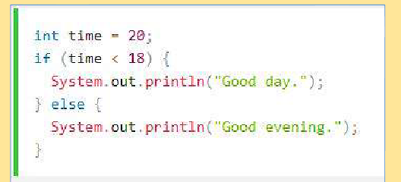
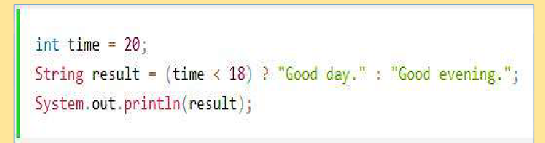
If...Else & Ternary Operator – A comparison

Slide 13
Java’s Selection Statements -SWITCH
The switch statement is Java’s multiway branch statement. It provides an easy way to dispatch execution to different parts of your code based on the value of an expression.
As such, it often provides a better alternative than a large series of if-else-if statements.
Here is the general form of a switch statement:
switch (expression)
{
case value1:
// statement sequence
break;
case value2:
// statement sequence
break;
...
case valueN:

Slide 14
Switch
// statement sequence
break;
default:
// default statement sequence
}
The expression must be of type byte, short, int, or char;
Each of the values specified in the case statements must be of a type compatible with the expression.
The value of the expression is compared with each of the literal values in the case statements. If a match is found, the code sequence following that case statement is executed.
If none of the constants matches the value of the expression,then the default statement is executed.

Slide 15
Switch
The default statement is optional. If no case matches and no default is present, then no further action is taken.
The break statement is used inside the switch to terminate a statement sequence.
When a break statement is encountered, execution branches to the first line of code that follows the entire switch statement.
// A simple example of the switch.
class SampleSwitch {
public static void main(String args[]) {
for(int i=0; i<6; i++)
switch(i) {
case 0:
System.out.println("i is zero.");
break;

Slide 16
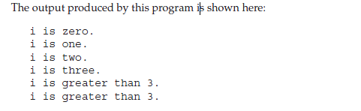
Switch
case 1:
System.out.println("i is one.");
break;
case 2:
System.out.println("i is two.");
break;
case 3:
System.out.println("i is three.");
break;
default:
System.out.println("i is greater than 3.");
}
}
}

Slide 17
Switch
class Switch { public static void main(String args[]) { int month = 4; String season; switch (month) { case 12: case 1: case 2: season = "Winter"; break; case 3: case 4: case 5: season = "Spring"; break; | case 6: case 7: case 8: season = "Summer"; break; case 9: case 10: case 11: season = "Autumn"; break; default: season = "Bogus Month"; } System.out.println("April is in the " + season + "."); } }

Slide 18
Nested switch Statements
switch(count) {
case 1:
switch(target) { // nested switch
case 0:
System.out.println("target is zero");
break;
case 1: // no conflicts with outer switch
System.out.println("target is one");
break;
}
break;
case 2: // ...

Slide 19
Switch vs IF
The switch differs from the if in that switch can only test for equality, whereas if can evaluate any type of Boolean expression.
That is, the switch looks only for a match between the value of the expression and one of its case constants.
No two case constants in the same switch can have identical values.
Of course, a switch statement and an enclosing outer switch can have case constants in common.
A switch statement is usually more efficient than a set of nested ifs.
If you need to select among a large group of values,a switch statement will run much faster than the equivalent logic coded using a sequence of if-elses.

Slide 20
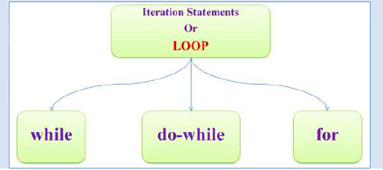
Iteration Statements
Java’s iteration statements are for, while, and do-while.
These statements create what we commonly call loops.
A loop repeatedly executes the same set of
instructions until a termination condition is met.
while
The while loop is Java’s most fundamental loop statement. It repeats a statement or block while its controlling expression is true. Here is its general form:
while(condition) {
// body of loop
}

Slide 21
Iteration Statements
while
The condition can be any Boolean expression. The body of the loop will be executed as long as the conditional expression is true.
When condition becomes false, control passes to the next line of code immediately following the loop.
The curly braces are unnecessary if only a single statement is being repeated.
Since the while loop evaluates its conditional expression at the top of the loop, the body of the loop will not execute even once if the condition is false to begin with.

Slide 22
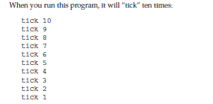
Iteration Statements
while
// Demonstrate the while loop.
class While {
public static void main(String args[]) {
int n = 10;
while(n > 0)
{
System.out.println("tick " + n);
n--;
}}
}

Slide 23
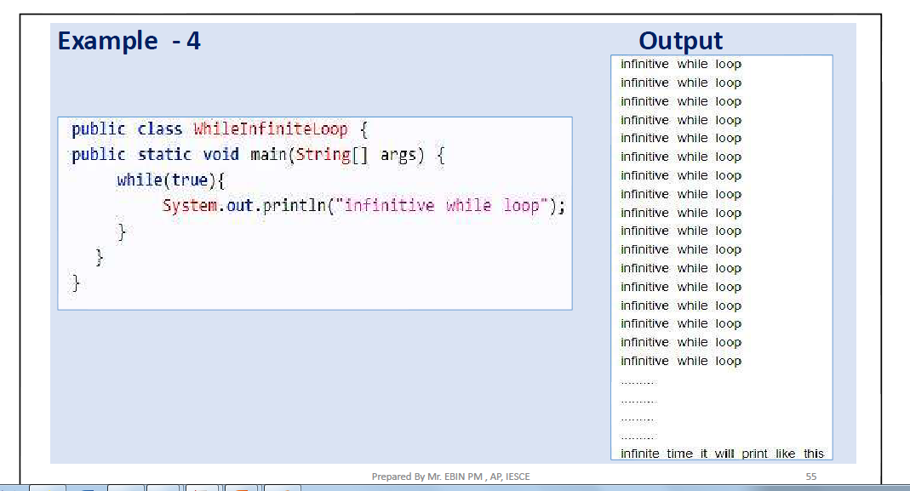
Iteration Statements
While Infinite loop

Slide 24
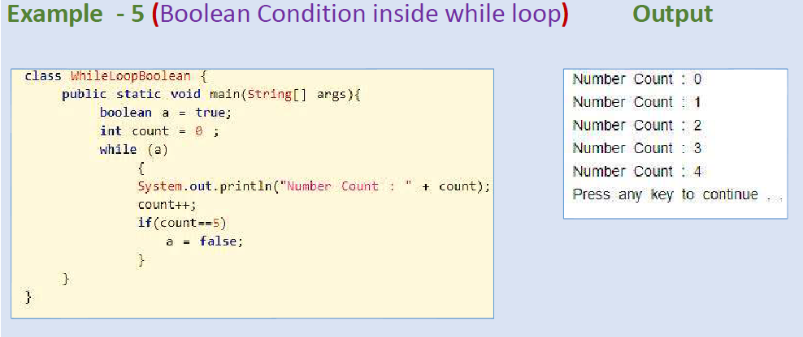
Iteration Statements
While Infinite loop

Slide 25
Iteration Statements
do-while
The do-while loop always executes its body at least once, because its conditional expression is at the bottom of the loop.
Its general form is
do {
// body of loop
} while (condition);
Each iteration of the do-while loop first executes the body of the loop and then evaluates the conditional expression. If this expression is true, the loop will repeat.
Otherwise, the loop terminates. As with all of Java’s loops, condition must be a Boolean expression.

Slide 26
Iteration Statements
do-while
// Demonstrate the do-while loop.
class DoWhile {
public static void main(String args[]) {
int n = 10;
do {
System.out.println("tick " + n);
n--;
} while(n > 0);
}
}

Slide 27
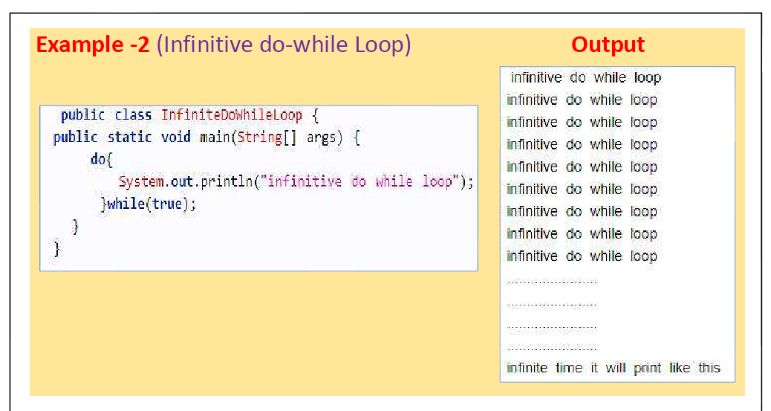
Iteration Statements

Slide 28
Iteration Statements
For
Here is the general form of the traditional for statement:
for(initialization; condition; iteration) {
// body
}
If only one statement is being repeated, there is no need for the curly braces.
The for loop operates as follows. When the loop first starts, the initialization portion of the loop is executed. Generally, this is an expression that sets the value of the loop control variable, which acts as a counter that controls the loop.

Slide 29
Iteration Statements
for
The initialization expression is only executed once. Next, condition is evaluated. This must be a Boolean expression.
It usually tests the loop control variable against a target value.
If this expression is true, then the body of the loop is executed. If it is false, the loop terminates.
Next, the iteration portion of the loop is executed. This is usually an expression that increments or decrements the loop control variable.
The loop then iterates, first evaluating the conditional expression, then executing the body of the loop, and then executing the iteration expression with each pass.
This process repeats until the controlling expression is false.

Slide 30
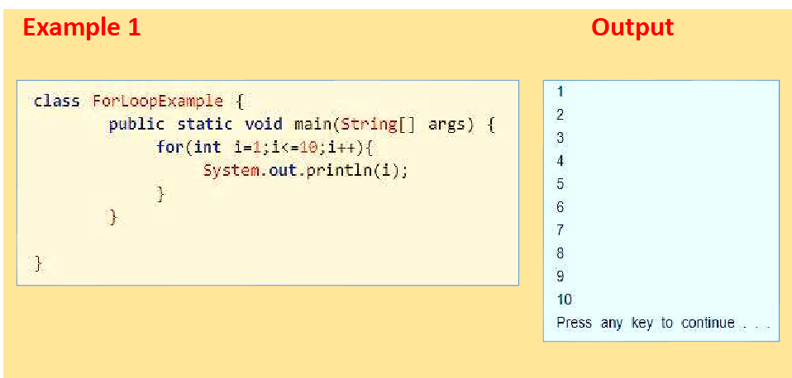
Iteration Statements
for

Slide 31
Iteration Statements
for
// Demonstrate the for loop.
class ForTick {
public static void main(String args[]) {
int n;
for(n=10; n>0; n--)
System.out.println("tick " + n);
}
}
Declaring Loop Control Variables Inside the for Loop
for(int n=10; n>0; n--)

Slide 32
Iteration Statements
Using the Comma in for loop
for(a=1, b=4; a<b; a++, b--) {
System.out.println("a = " + a);
System.out.println("b = " + b);
}

Slide 33
Iteration Statements
for( ; !done; ) {
System.out.println("i is " + i);
if(i == 10) done = true;
i++;
}
Infinite loop
for( ; ; ) {
// ...
}

Slide 34
Iteration Statements
The For-Each Version of the for Loop
A foreach style loop is designed to cycle through a collection of objects, such as an array, in strictly sequential fashion, from start to finish.
Java adds the for-each capability by enhancing the for statement.
The for-each style of for is also referred to as the enhanced for loop.
The general form of the for-each version of the for is shown here:
for(type itr-var : collection) statement-block
type specifies the type and itr-var specifies the name of an iteration variable that will receive the elements from a collection, one at a time, from beginning to end. The collection being cycled through is specified by collection.

Slide 35
Iteration Statements
The For-Each Version of the for Loop
With each iteration of the loop, the next element in the collection is retrieved and stored in itr-var.
The loop repeats until all elements in the collection have been obtained.
Because the iteration variable receives values from the collection, type must be the same as (or compatible with) the elements stored in the collection.
Thus, when iterating over arrays, type must be compatible with the base type of the array.

Slide 36
Iteration Statements
for loop
int nums[] = { 1, 2, 3, 4, 5, 6, 7, 8, 9, 10 };
int sum = 0;
for(int i=0; i < 10; i++)
sum += nums[i];
for-each Version of the for Loop
int nums[] = { 1, 2, 3, 4, 5, 6, 7, 8, 9, 10 };
int sum = 0;
for(int x: nums)
sum += x;

Slide 37
Iteration Statements
class ForEach2 {
public static void main(String args[]) {
int sum = 0;
int nums[] = { 1, 2, 3, 4, 5, 6, 7, 8, 9, 10 };
// use for to display and sum the values
for(int x : nums) {
System.out.println("Value is: " + x);
sum += x;
if(x == 5) break; // stop the loop when 5 is obtained
}
System.out.println("Summation of first 5 elements: " + sum);
}}

Slide 38
Iteration over multidimensional array
Write a program to use for-each style of for on a two-dimensional array.?

Slide 39
Search an array using for-each style for.
// Search an array using for-each style for.
class Search {
public static void main(String args[]) {
int nums[] = { 6, 8, 3, 7, 5, 6, 1, 4 };
int val = 5;
boolean found = false;
// use for-each style for to search nums for val
for(int x : nums) {
if(x == val) {
found = true;
break;
} }
if(found)
System.out.println("Value found!");
}}

Slide 40
Nested Loops
// Loops may be nested.
class Nested {
public static void main(String args[]) {
int i, j;
for(i=0; i<10; i++) {
for(j=i; j<10; j++)
{
System.out.print(".");
}
System.out.println();
}
}}

Slide 41
Jump Statements
Java supports three jump statements: break, continue, and return.
Using break
a.Using break to Exit a Loop
By using break, you can force immediate termination of a loop, bypassing the conditional expression and any remaining code in the body of the loop.
When a break statement is encountered inside a loop, the loop is terminated and program control resumes at the next statement following the loop.
When used inside a set of nested loops, the break statement will only break out of the innermost loop.

Slide 42
Jump Statements
Using break
// Using break to exit a loop.
class BreakLoop {
public static void main(String args[]) {
for(int i=0; i<100; i++) {
if(i == 10) break; // terminate loop if i is 10
System.out.println("i: " + i);
}
System.out.println("Loop complete.");
}
}

Slide 43
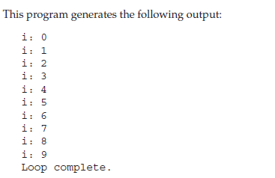
Jump Statements
Using break

Slide 44
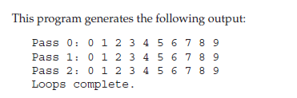
Jump Statements
class BreakLoop3 {
public static void main(String args[]) {
for(int i=0; i<3; i++) {
System.out.print("Pass " + i + ": ");
for(int j=0; j<100; j++) {
if(j == 10) break; // terminate loop if j is 10
System.out.print(j + " ");
}
System.out.println();
}
System.out.println("Loops complete.");
} }

Slide 45
Jump Statements
b. Using break as a Form of Goto
Java does not have a goto statement.
The break statement can also be employed by itself to provide a “civilized” form of the goto statement.
The general form of the labelled break statement is shown here:
break label;
label is the name of a label that identifies a block of code.
A label is any valid Java identifier followed by a colon.
Once you have labeled a block, you can then use this label as the target of a break statement.

Slide 46
Jump Statements
b. Using break as a Form of Goto
// Using break inside inner loop. class Break { public static void main(String args[]) { boolean t = true; first: { second: { third: { System.out.println("Before the break."); if(t) break second; // break out of second block | System.out.println("This won't execute"); } System.out.println("This won't execute"); } System.out.println("This is after second block."); } } } OUTPUT Before the break. This is after second block.

Slide 47
Jump Statements
b. Using break as a Form of Goto
// Using break to exit from nested loops class BreakLoop4 { public static void main(String args[]) { outer: for(int i=0; i<3; i++) //labeled for loop { System.out.print("Pass " + i + ": "); for(int j=0; j<100; j++) { if(j == 10) break outer; // exit both loops | System.out.print(j + " "); } System.out.println("This will not print"); } System.out.println("Loops complete."); } } OUTPUT: Pass 0: 0 1 2 3 4 5 6 7 8 9 Loops complete.

Slide 48
Jump Statements
2. Using continue
The Java continue statement is used to continue the loop.
In while and do-while loops, a continue statement causes control to be transferred directly to the conditional expression that controls the loop.
In a for loop, control goes first to the iteration portion of the for statement and then to the conditional expression.
It continues the current flow of the program and skips the remaining code at the specified condition..

Slide 49
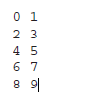
Jump Statements
2. Using continue
class Continue {
public static void main(String args[])
{
for(int i=0; i<10; i++)
{
System.out.print(i + " ");
if (i%2 == 0) continue;
System.out.println("");
}
}
}

Slide 50
Jump Statements
3. Return
The last control statement is return.
The return statement is used to explicitly return from a method.
That is, it causes program control to transfer back to the caller of the method.
At any time in a method the return statement can be used to cause execution to branch back to the caller of the method.

Slide 51
Jump Statements
3. Return
class Return {
public static void main(String args[]) {
boolean t = true;
System.out.println("Before the return.");
if(t) return; // return to caller
System.out.println("This won't execute.");
}}
OUTPUT : Before the return.
As you can see, the final println( ) statement is not executed. As soon as return is executed, control passes back to the caller.

Slide 52
Thanks!
Any questions?

